Slide 1
Sentiment Analysis using Mamba Intelligence
Aditya Raju
Kartekeya Sharma

Slide 2
Project Overview
Title: Sentiment Analysis with Mamba Intelligence
Purpose: To implement adaptive, multilingual sentiment analysis for social media platforms
Motivation: Addressing challenges in real-time sentiment detection, language diversity, and dynamic content on social media
Objective: Enhance accuracy, scalability, and language adaptability using Mamba Intelligence

Slide 3
Model and Framework
Model:
Utilizes adaptive models with pre-trained transformers like multilingual BERT
Real-time learning for continuous improvement and response to emerging slang and idioms
Mamba Intelligence Architecture:
Tokenization and Embeddings: Language-specific tokenizers, embeddings for cross-language semantics
Transformer Core: Manages context-aware sentiment prediction
Adaptive Learning: Dynamically adjusts based on language trends without retraining

Slide 4
Dataset and Experimental Setup
1.Dataset:
Collection of labeled social media posts from platforms like Twitter, Facebook, Instagram
Multilingual, covering diverse languages and dialects
2.Metrics:
Accuracy: Correct sentiment classifications
Precision: Positive sentiment prediction accuracy
Recall: Completeness of sentiment predictions
F1 Score: Balance between precision and recall
3.Comparison Baselines:
Differs from fixed-premium models, boosting market appeal.

Slide 5
Tools and Software Architecture
1. Tools
Languages: Python (for model development), TensorFlow Lite (for deployment on edge devices)
Frameworks: Mamba Intelligence, multilingual BERT
Distributed Computing: Parallel processing for scalability
2. Software Architecture
Real-time Data Integration: Processes high-volume social media data
Dynamic Resource Allocation: Adapts computational resources to data spikes, ensuring continuous processing

Slide 6
Results and Analysis
Performance Comparison
Mamba Intelligence outperforms baseline models in multilingual sentiment detection
Achieves higher F1 scores and reduced errors, especially with small training datasets
Effectiveness in detecting sentiment across languages and informal social media expressions
Insights
Mamba’s ability to handle multilingual inputs enhances usability and global reach

Slide 7
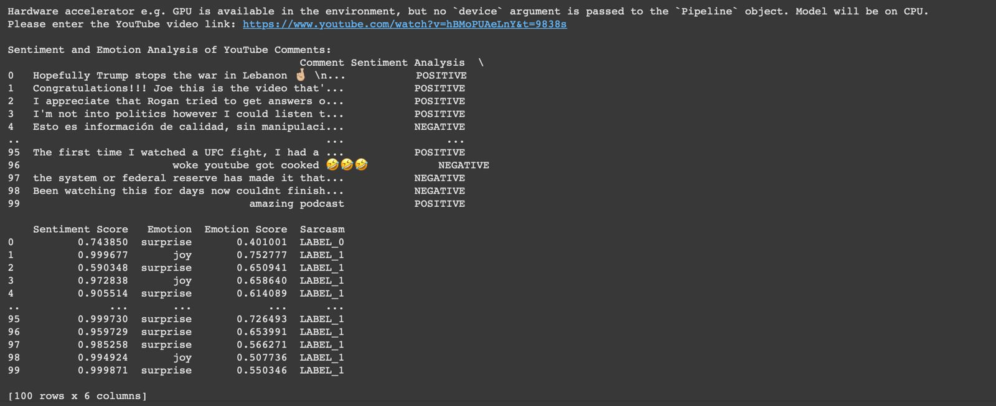
Output

Slide 8
Future Work
Multimodal Sentiment Analysis: Integrate text, image, and video for richer sentiment insights
Dialect Expansion: Enhance support for dialects and underrepresented languages
Scalability: Further refine adaptive scaling for global social media sentiment analysis applications

Slide 9
Thank you!

